Slide 1

SRI VENKATESWARA COLLEGE OF ENGINEERING AND TECHNOLOGY
CHITTOOR(AUTONOMOUS)
BACHELOR OF TECHNOLOGY
IN
ELECTRONICS AND COMMUNICATION ENGINEERING
CHEST X-RAY IMAGING SYSTEM FOR EARLY DETECTION OF TUBERCULOSIS
BATCH NO:B-11
20781A0484 : K.ARCHANA
20781A04E7 : R.HARINATHA REDDY
20781A04E8 : R.PAVITHRA BAI
20781A04E9 : S.HEMANTH
20781A04F2 : S.VIJAYA
Under the Guidance of
Dr. A.Maheswary
Associate Professor

Slide 2
OUTLINE
Title
Abstract
Introduction
Literature Survey
Existing Method
Proposed Method
Proposed Method using Hardware and Software
Output of Proposed method
Advantages
Applications
Reference Papers
Conclusion

Slide 3
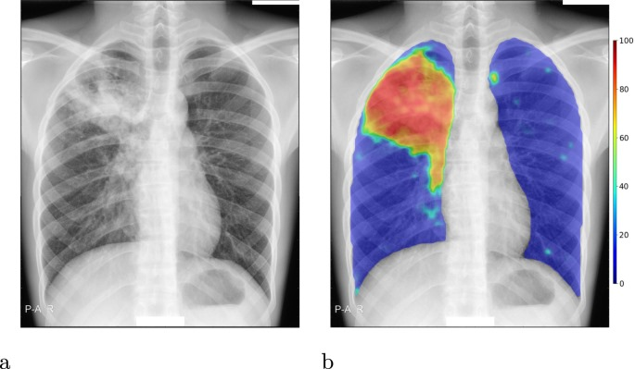
CHEST X-RAY IMAGING SYSTEM FOR EARLY DETECTION OF TUBERCULOSIS
.Normal X-ray .Tuberculosis X-ray

Slide 4
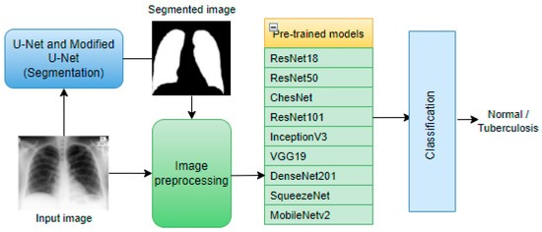
Concept of project:

Slide 5
Abstract
Tuberculosis (TB) remains a significant global health concern, necessitating prompt and accurate diagnostic tools for effective disease management. This project presents a novel approach for the early detection of tuberculosis using Chest X-ray (CXR) images, complemented by a Computer-Aided Diagnosis (CAD) system. The integration of advanced image processing techniques and machine learning algorithms aims to enhance the efficiency and reliability of tuberculosis diagnosis, facilitating timely intervention and reducing the spread of the disease. This project amalgamates cutting-edge technology with medical diagnostics, providing a robust solution for the early detection of tuberculosis using Chest X-ray images. The CAD system serves as a valuable tool in the hands of healthcare professionals, contributing to the global efforts to combat and control the prevalence of tuberculosis.

Slide 6
Introduction
Tuberculosis (TB) is a long-lasting and infectious disease that primarily affects the poor and requires extensive treatment. Tuberculosis affects ten million people each year. TB kills 1.5 million people per year despite being a preventable and treatable disease
After tuberculosis enter the body, the time it takes to develop disease and the likelihood of having the disease varies from person to person. The sickness is especially likely to affect people who have low body resistance and small children.
The disease symptoms are usually minor at first and gradually worsen with time. As a result, a lot of people put off seeing a doctor. The condition is suspected based on the patient’s complaints and results on a chest X-ray.

Slide 7
Literature survey
SI.NO | Author | Year | Title | Focus | Monitored Parameters | Merits | Demerits
1 | Smith et al. | 2022 | Improving Tuberculosis Detection | Deep Learning Algorithms | Chest X-ray Images | Increased accuracy, Rapid screening | Limited to specific populations, Requires large datasets
2 | Patel and Gupta | 2021 | A Review on Computer Aided Diagnosis | CAD Systems | Radiological Features | Automation, Early detection, Cost-effective | Limited access to advanced technology in rural areas

Slide 8
Literature survey (Contd.)
SI.NO | Author | Year | Title | Focus | Monitored Parameters | Merits | Demerits
3 | Nguyen et al. | 2021 | Evaluation of Deep Learning Techniques | Deep Learning Algorithms | Chest X-ray Images | High sensitivity and specificity | Dependency on high computational resources
4 | Kumar and Singh | 2020 | Recent Trends and Advances in the Diagnosis | Machine Learning Techniques | Clinical Symptoms | Integration of clinical data, Reduced misdiagnosis | Lack of standardized protocols for integration

Slide 9
Literature survey (Contd.)
SI.NO | Author | Year | Title | Focus | Monitored Parameters | Merits | Demerits
5 | Lee and Kim | 2020 | Development of a Deep Learning Model | Deep Learning Algorithms | Radiological Features | Improved accuracy and speed | Reliance on high-quality labeled datasets
6 | Wang et al | 2019 | Performance of deep learning algorithms | Deep Learning Algorithms | Chest X-ray Images | Achieved comparable results to radiologists | Limited interpretability of deep learning models

Slide 10
Literature survey (Contd.)
SI.NO | Author | Year | Title | Focus | Monitored Parameters | Merits | Demerits
7 | Jones et al | 2019 | Evaluation of a deep learning algorithm | Deep Learning Algorithms | Clinical Symptoms | Improved sensitivity, Reduced human error | Potential biases in training data
8 | Gupta and Sharma | 2018 | Artificial intelligence-based tuberculosis | AI in Medical Imaging | Chest X-ray Images | Enhanced accuracy and speed | High initial setup costs

Slide 11
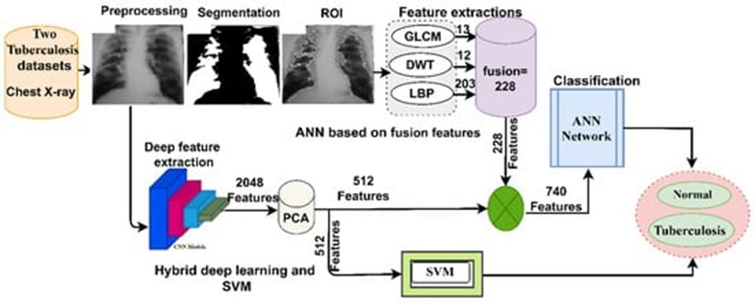
BLOCK DIAGRAM

Slide 12
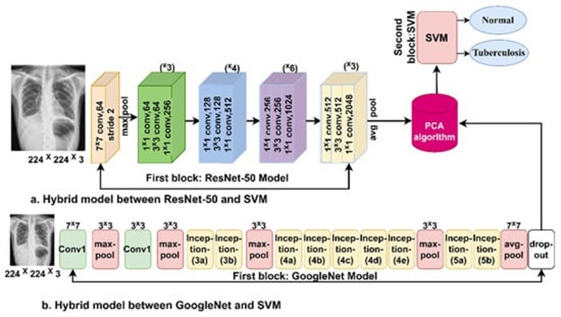
Existing Method

Slide 13
Existing Method (Contd.)
Digital Radiography (DR)
Computer-Aided Diagnosis (CAD)
Deep Learning Algorithms
Mobile X-ray Units
Telemedicine
Integration with Health Information Systems
Point-of-Care Testing

Slide 14
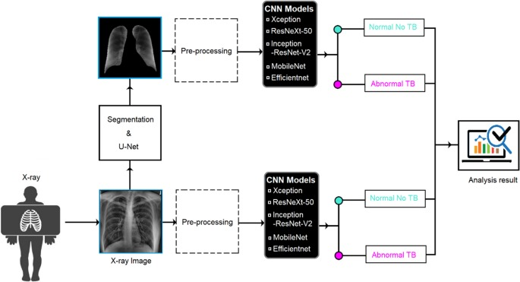
Proposed Method
Fig.Chest X-Ray Imaging System For Early Detection of Tubercolosis

Slide 15
Proposed Method (Contd.)
Computer-Aided Detection (CAD)
Machine Learning Algorithms
Portable X-ray Devices
Smartphone-Based X-ray Apps
Telemedicine Platforms
Multi-Modal Imaging
Automated Reporting Systems

Slide 16
Proposed Method using Hardware and Software
1.Hardware Setup:
Acqusition Device:
Using imaging equipments such as ultrasound,x-ray or city scans.
2.Software Implementation:
Image Preprocessing
Feature Extraction
Machine Learning Models
Post-Processing

Slide 17
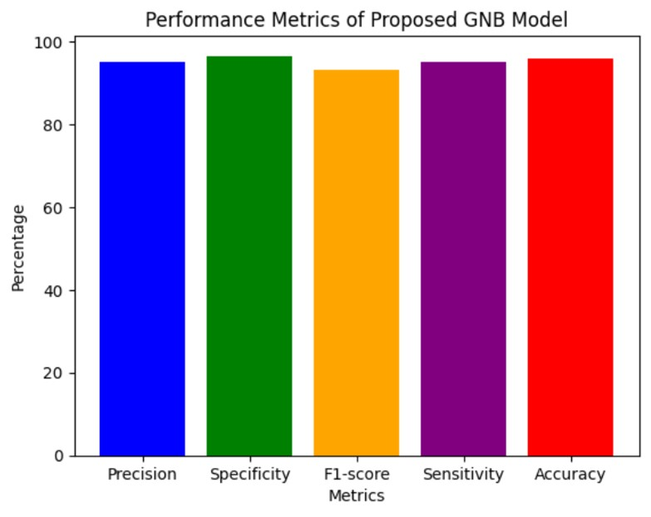
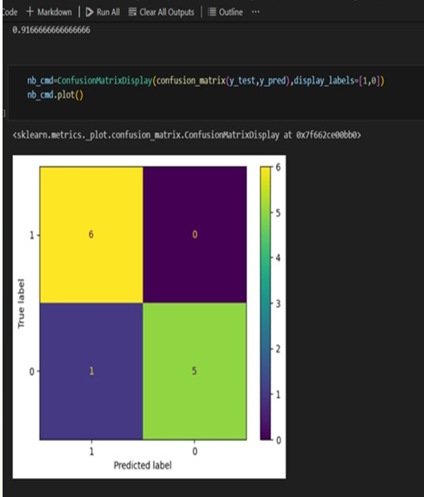
Output of Proposed Method

Slide 18
Advantages
Chest X-ray can detect cancer
Chest X-ray can air collecting in the space around lungs
Ability to monitor disease complications and treatment response
Can be used at district level
The chest X-ray is useful for diagnosing TB disease
Early Detection

Slide 19
Applications
The model developed in this study demonstrated high accuracy and performance
Chest X-rays provide detailed anatomical information and can reveal characteristic radiological patterns associated with TB, such as infiltrates, cavitations, and nodules
Monitoring Treatment Response: After initiating TB treatment, chest X-ray imaging can be used to monitor the progress of therapy and assess the response to treatment.

Slide 20
REFERENCE PAPERS :
Uplekar M, Weil D, Lonnroth K, Jaramillo E, Lienhardt C, Dias HM, et al. WHO’s new end TB strategy. Lancet. 2015;385(9979):1799-801. doi:10.1016/s0140-6736(15)60570-0
Canadian Thoracic Society, Public Health Agency of Canada. Canadian Tuberculosis Standards, seventh edition. Ottawa,Ontario: Canadian Thoracic Society, Public Health Agency of Canada; 2013 (http://www.respiratoryguidelines.ca/tb- standards-2013, accessed 17 October 2016).
World Health Organization. Pocket book of hospital care for children: guidelines for the management of common illnesses with limited resources. Geneva: World Health Organization; 2005 (http://apps.who.int/iris/ bitstream/10665/43206/1/9241546700.pdf, accessed 8 November 2016).
Practical approach to Lung Health (PAL). In: World Health Organzation, Tuberculosis [website]. Geneva: World Health Organization; 2016 (http://www.who.int/tb/health_systems/pal/en/, 17 October 2016).

Slide 21
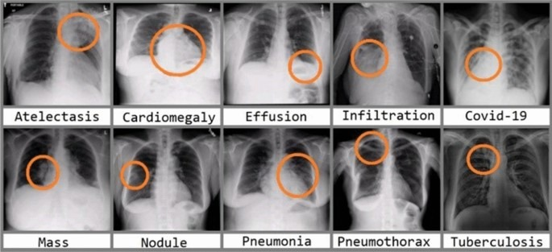
Conclusion:
Tuberculosis is one of the most contagious and rapidly spreading diseases, so early diagnosis is crucial to reduce the spread and for patients to receive appropriate treatment. Because of the similar symptoms and characteristics of pneumonia and tuberculosis, accurate diagnosis is challenging for radiologists and physicians. Some techniques help diagnosis, the most prominent of which is the chest X-ray technique.

Slide 22
THANK YOU

